Slide 1
E-Safety Training 2018
Spring Vale Primary School

Slide 2
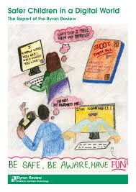
But, was the internet made for children?

Slide 3
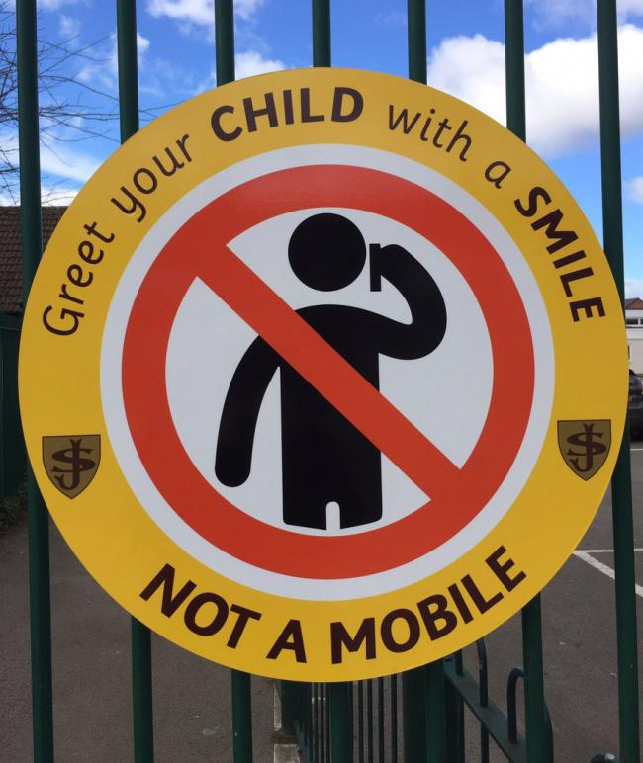
Ultimately, it is a parental issue!!

Slide 4
The latest trends/threats
Spring Vale Primary School

Slide 5
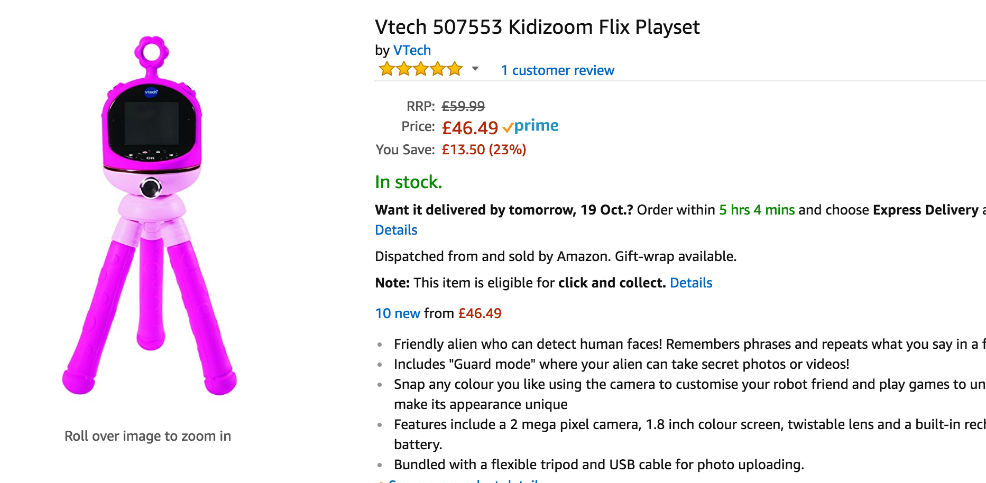
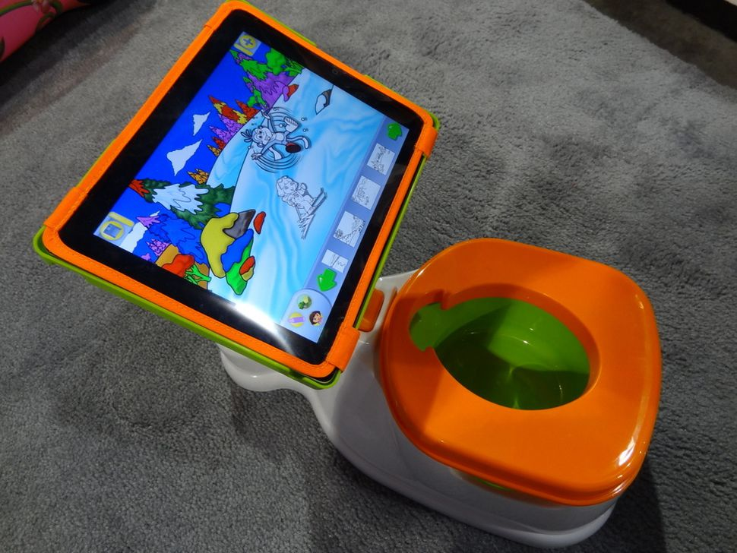
Tech Toddlers

Slide 6
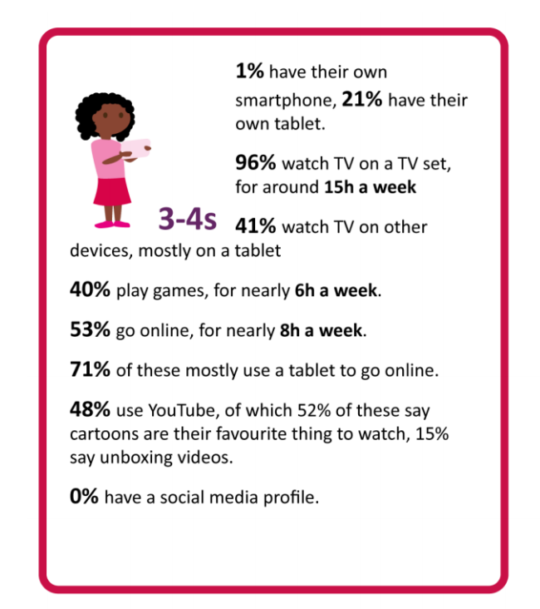
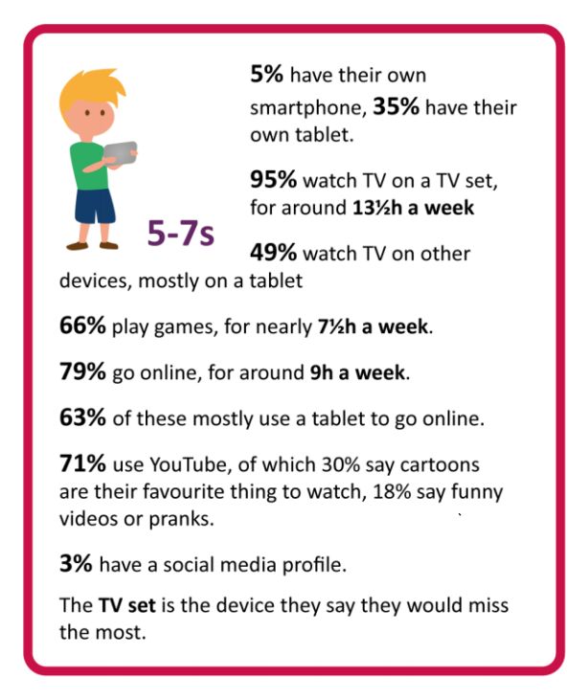
Children’s Media Lives
https://www.ofcom.org.uk/__data/assets/pdf_file/0020/108182/children-parents-media-use-attitudes-2017.pdf

Slide 7
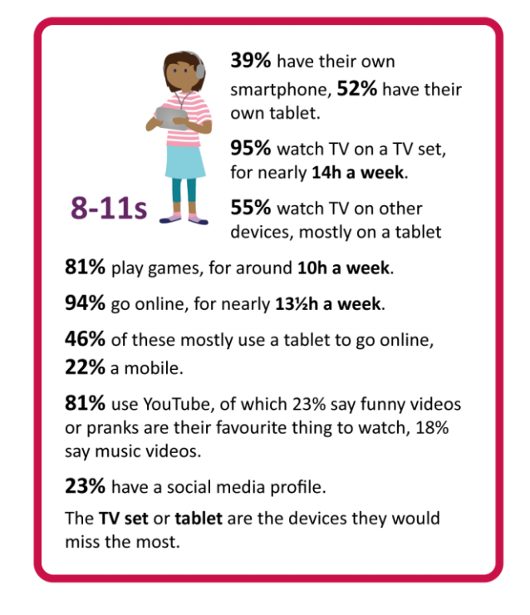
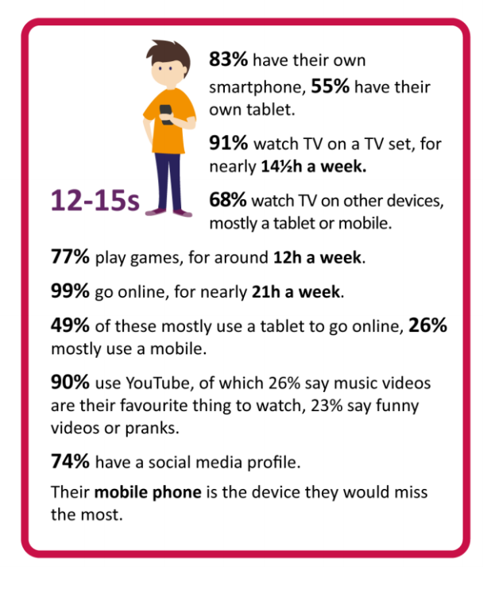
Children’s Media Lives
https://www.ofcom.org.uk/__data/assets/pdf_file/0020/108182/children-parents-media-use-attitudes-2017.pdf

Slide 8
Today’s stars for children…
Dan TDM
Zolella
Harry Lewis

Slide 9
But the problem with YT is…
http://bit.ly/2DRnFea
http://bit.ly/2Cr8hbF

Slide 10
But the problem with YT is…
http://bit.ly/2yNJr4v

Slide 11
So what is e-safety?
Spring Vale Primary School

Slide 12
What is e-safety?
Content: being exposed to illegal, inappropriate or harmful
material
Contact: being subjected to harmful online interaction with other users
Conduct: personal online behaviour that increases the likelihood of, or causes, harm.

Slide 13
The three ‘C’s’
Accessing adult websites
Cyberbullying
Trolled on SM
Radicalised by Social Media
Online Stalking
Coerced into sending images
Take part in dangerous challenges
Addicted to gambling sites
Groomed
Play inappropriate video games
Sending Sexting images

Slide 14
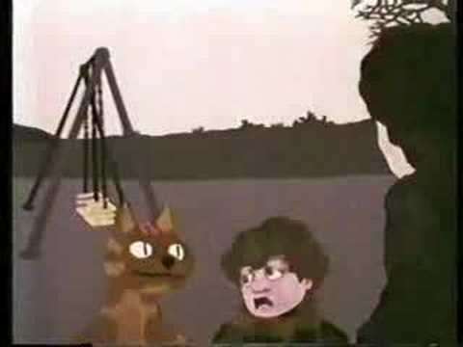
Back In The Day…Same Fears

Slide 15
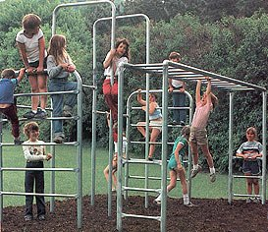
We have always had predators

Slide 16
The Grooming Process
https://www.channel4.com/news/children-bombarded-with-sexually-explicit-chat-on-musical-ly-and-live-ly

Slide 17
Popular apps for children/young people?

Slide 18
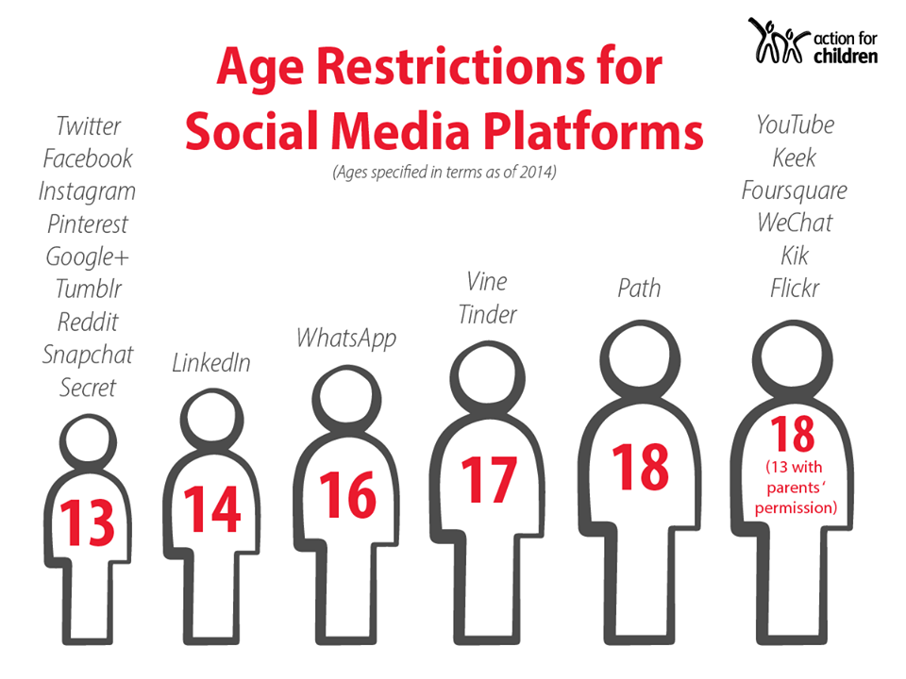

Slide 19
Useful Sites
CEOP (TUK): https://www.thinkuknow.co.uk/
Internet Matters: https://www.internetmatters.org/
Common Sense Media (US): https://www.commonsensemedia.org/

Slide 20
Youth Produced Sexual Imagery
Spring Vale Primary School

Slide 21
Defining ‘Sexting’
”Writing and sharing explicit messages or images with people they know”
”Sending or posting sexually suggestive images, including nude or semi-nude photographs, via mobiles or the internet”

Slide 22
Sexting - Why?
joining in because they think that ‘everyone is doing it’
boosting their self-esteem
flirting with others and testing their sexual identity
exploring their sexual feelings
to get attention and connect with new people on social media
they may find it difficult to say no if somebody asks them for an explicit image, especially if the person asking is persistent

Slide 23
Ages Getting Lower

Slide 24
The Sexual Offences Act (2003)
Illegal to create, share and possess any ‘indecent’ image of anyone under the age of 18.

Slide 25
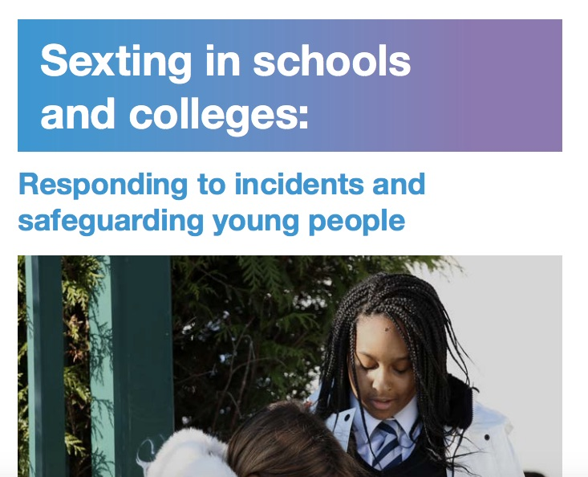
Guidance document and should be used in conjunction with ‘Keeping Children Safe In Education’ (2016)

Slide 26
Cyberbullying
Spring Vale Primary School

Slide 27
Online Bullying - Definition
“Cyberbullying is bullying that takes place using electronic technology. Electronic technology includes devices and equipment such as cell phones, computers, and tablets as well as communication tools including social media sites, text messages, chat, and websites.”

Slide 28
Terms
Keyboard Warrior
Troll
Slut shaming
Troll Bait
Baited Out
Whispers
Internet Tough Guy
Cyberbullicide
Catfishing
Trash Talk
Flaming

Slide 29
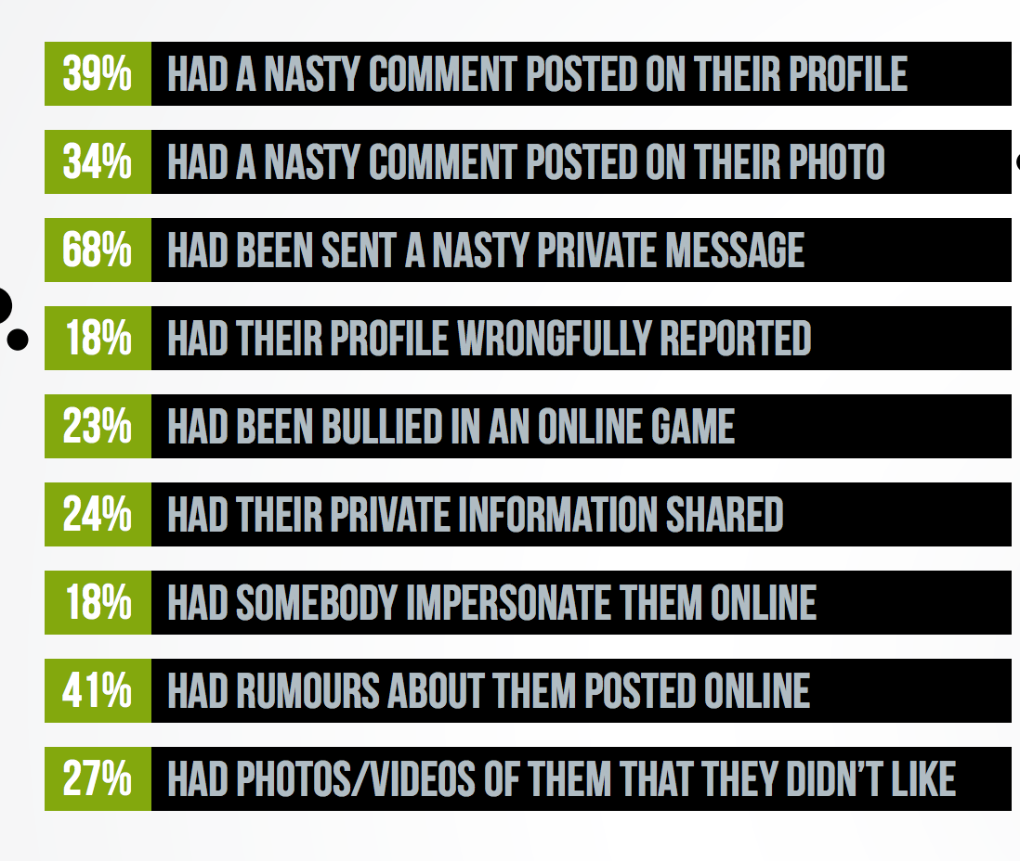
Research – ‘Ditch The Label’
https://www.ditchthelabel.org/wp-content/uploads/2017/07/The-Annual-Bullying-Survey-2017-1.pdf

Slide 30
Impact
Depression
Social Anxiety
Suicidal Thoughts
Self Harm
Deleted Social Media
Truanted
Drug/Alcohol Abuse
Eating Disorder

Slide 31
Impact

Slide 32
’Cyberbullying’
• Focus in primary schools about ‘netiquette’ and being kind to others on the internet.
• Use of language to ‘digital citizenship, rewarding pupils for their positive behaviour online.
• Discussion around ‘reclaim the internet’ giving people the opportunity to express their views.
• Ensuring that young people know how to ‘report’ and ‘block’ online bullies.

Slide 33
Finally…
Spring Vale Primary School

Slide 34
The world ahead…
• The first implantable mobile phone will become commercially available in 2025.
• 10% of reading glasses will be connected to the internet by 2023.
• More than 50% of Internet traffic to homes will be from appliances and device by 2024.
• 80% of people on earth will have a digital presence online by 2023.

Slide 35
Copyright Notice
All resources remain copyright of T C Pinto e-safety consultancy.
Delegates may use slides for their private use only and must NOT use them for any training purposes.
© T Pinto e-safety Consultant, 2017
Images cc https://pixabay.com/

