Slide 1
NSPCC ONLINE SAFETY

Slide 2
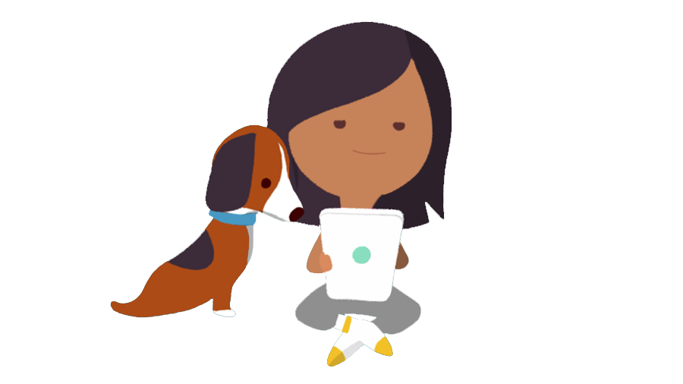
Online Safety
Instagram
Snapchat
YouTube
Minecraft

Slide 3
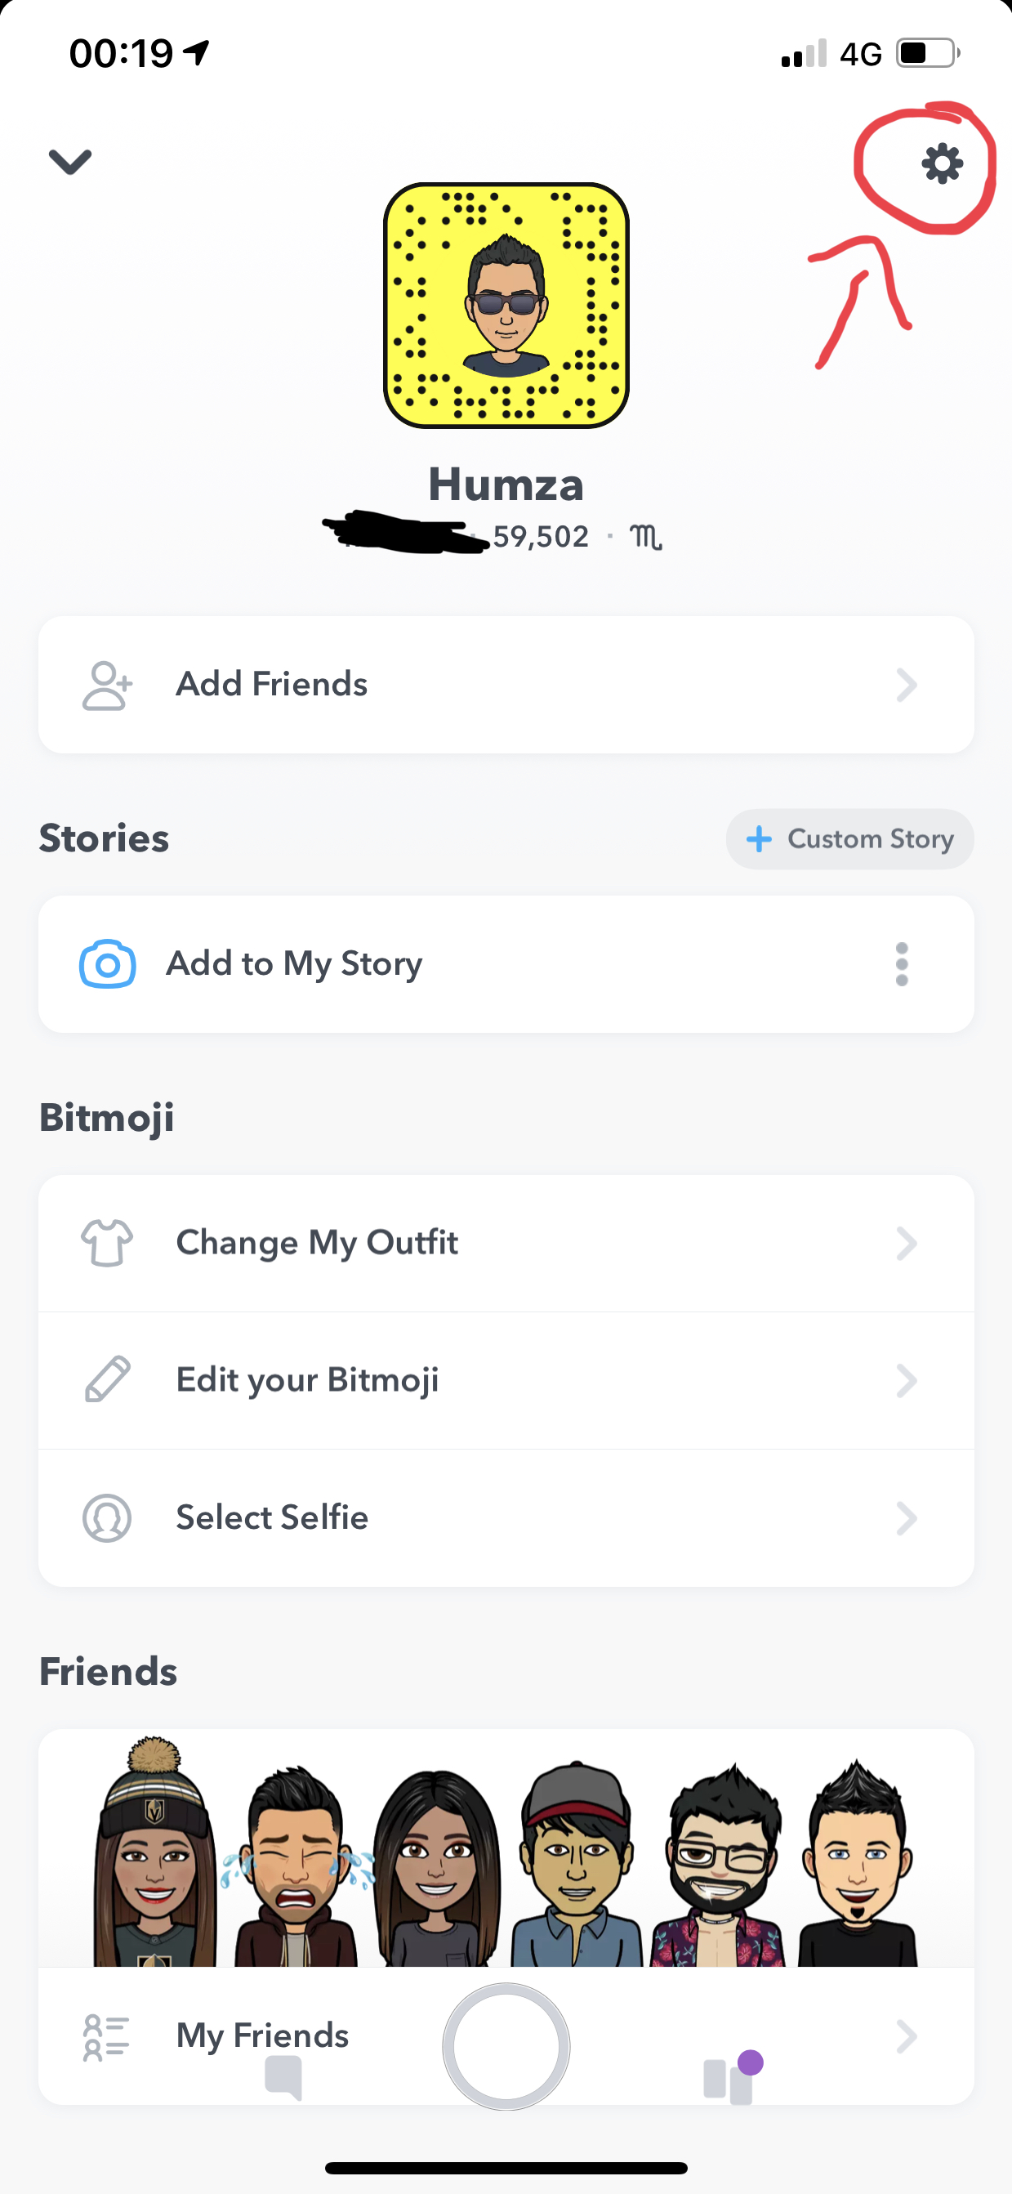
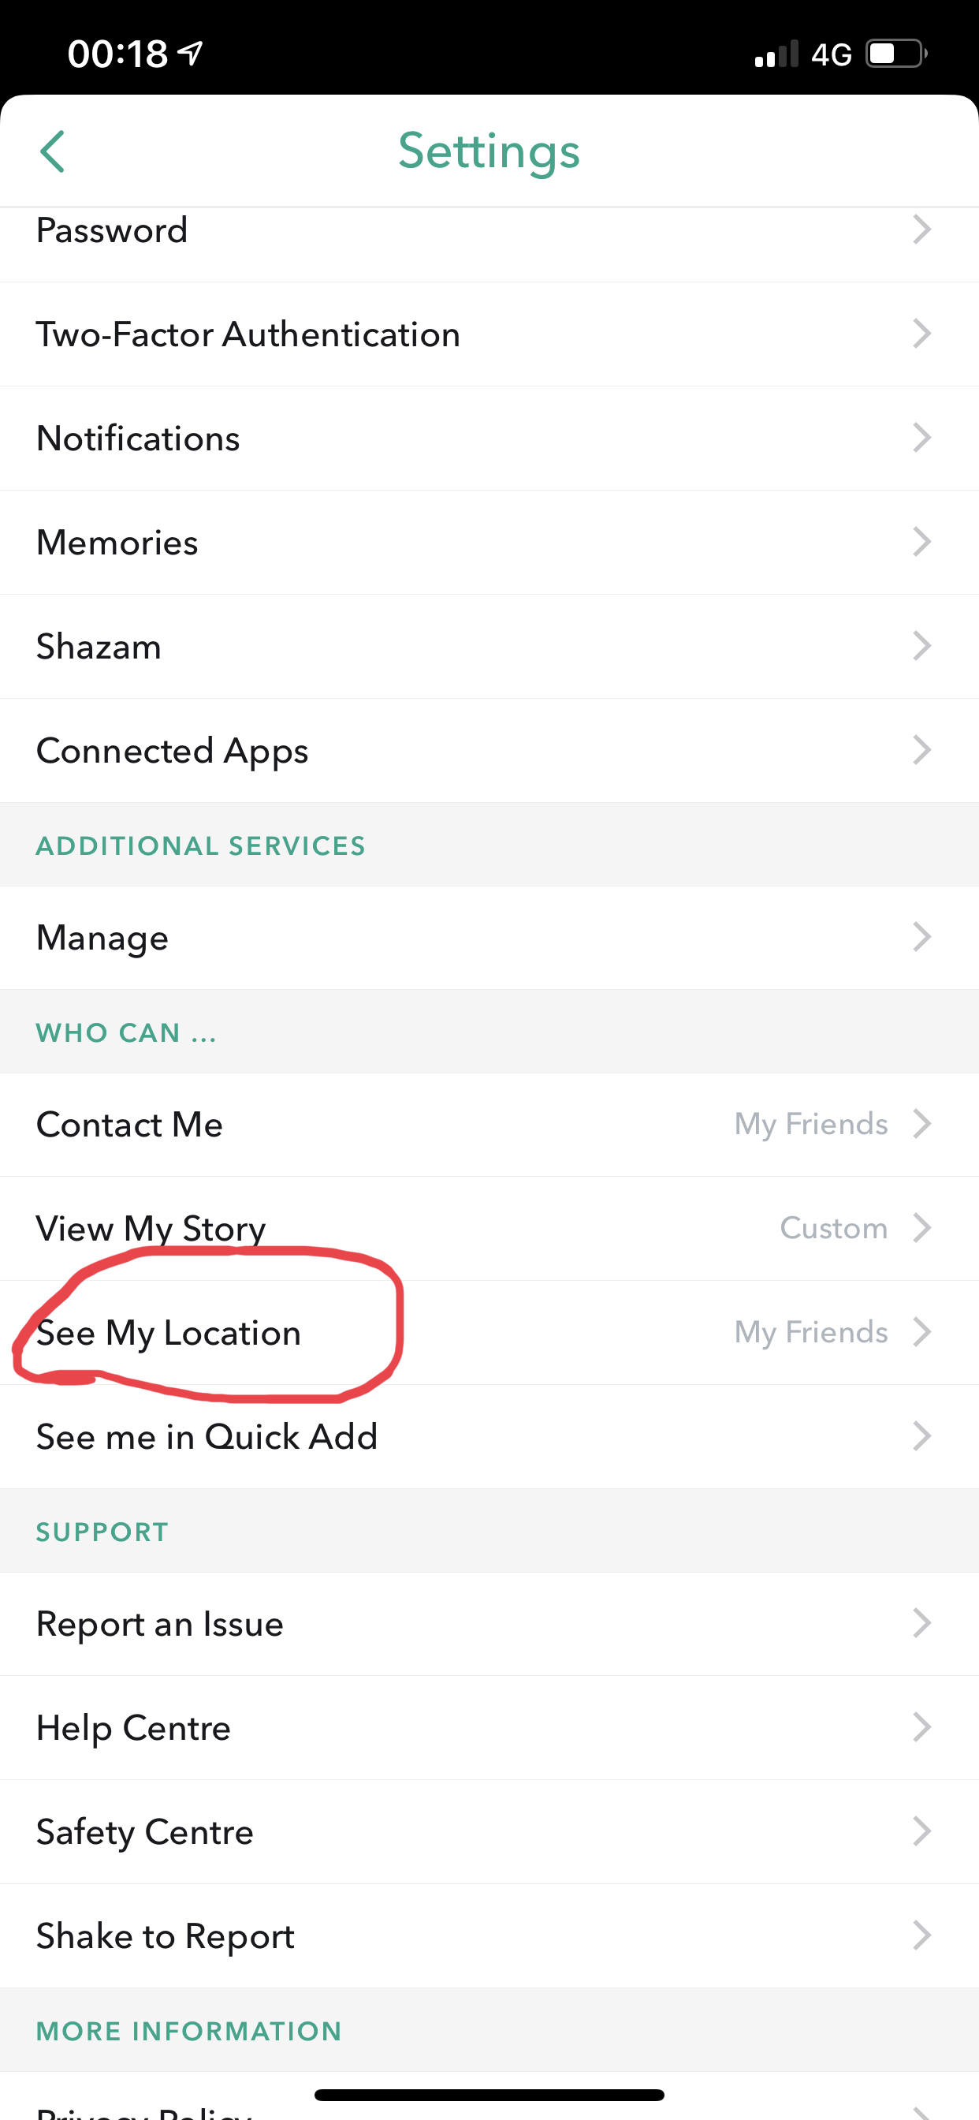
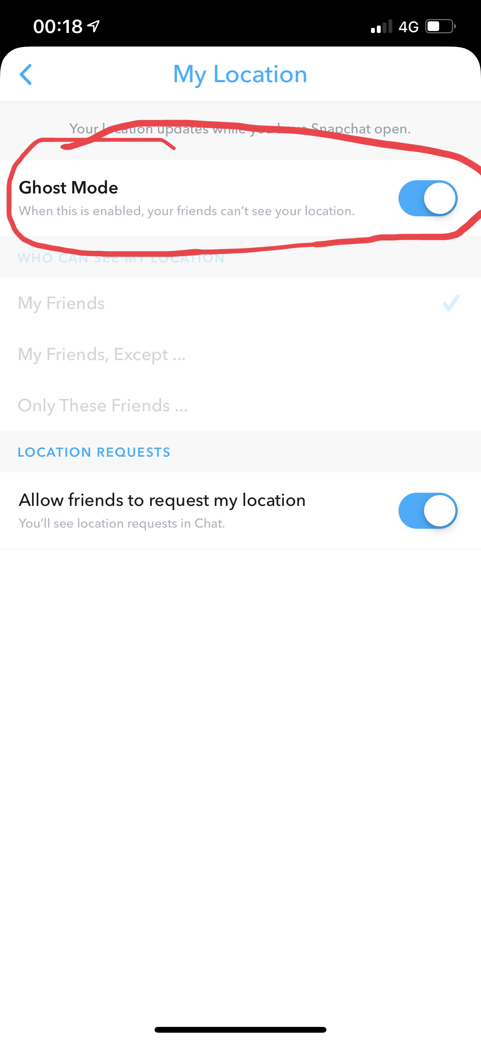
How Can You Make Yourself Safe?
Make your account private!
Here's how…
Only add/follow people you know
Turn Location Settings off
Here's how…

Slide 4
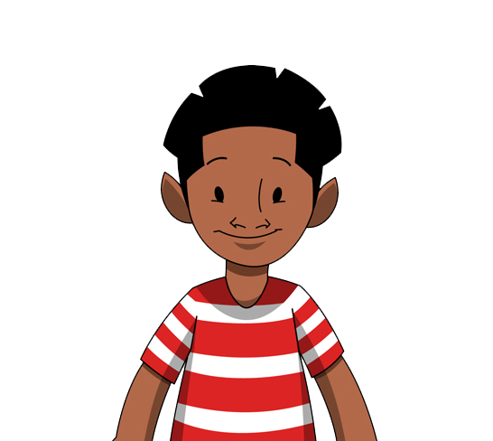
What Behaviors Are Not Okay Online?
Verbal Abuse – Name Calling, Saying Nasty Things
Emotional Abuse – Trying To Humiliate You, Scare You
Online Abuse – Sending Abusive Messages, Sharing Embarrassing Pictures

Slide 5
Useful Tools?
NSPCC HELPLINE: 08088005000
Talk To Someone Who You Can Trust – Parents, Teachers, Brother/Sister, Guardian, Friend
Treat People How You Like To Be Treated

Slide 12
Group Activity
Word Search!
Work together in pairs to complete both online safety word searches
The quickest pair wins a prize!

