Slide 1
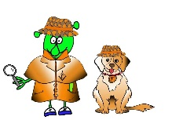
Spanish Y3 Stage 1 Autumn 2:Months.
Language Detectives’ Memory Bank of “Months”
Noun Bank
enero- January
febrero- February
marzo- March
abril- April
mayo- May
junio- June
julio- July
agosto- August
septiembre
octubre
noviembre
diciembre
Grammar
When words are the same in two languages we call them cognates and when they look very similar we call them semi-cognates.
Sound spelling
“j”
“i”
“ciem”
Fact Bank
Lots of the months in Spanish look very similar to English spelling if the months. There are no capital letters in Spanish at the start of the month.
Question and Answer Bank
¿Cuando es tu cumpleaňos?- When is your birthday?

