Slide 1
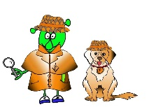
Spanish Y4 Stage 2 Autumn 2:Classroom Commands.
Language Detectives’ Memory Bank of “Classroom Commands”
Verb Bank
All the words below are part of verbs when we instruct more than one person to do something.
Mirad- look
Escuchad- listen
Repetid- repeat
Levantaos- stand up
Sentaos- sit down
Contad- count
Cantad- sing
Enseñadme - show me
Buscad – look for
Verb Bank
All the words below are part of verbs when we instruct one person to do something.
Mira- look
Escucha- listen
Repite- repeat
Levántate- stand up
Siéntate- sit down
Cuenta- count
Canta- sing
Enséñame- show me
Busca – look for
Sound spelling
“uch”
“ite”
“aos”

