Slide 1
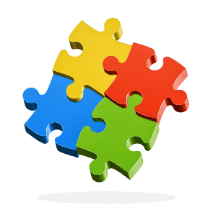
Maths
# Everyone Can
I can recall and use number bonds
I know that mistakes help me learn
I can use maths to solve everyday problems
I can make connections
I know that trying different strategies can help me to solve a problem
8
2

